Slide 1
Eclipse Plug-in Development
Eclipse Plug-in Development Part 5
Extensions and Extension Points

Slide 2
Contents
Overview
Extension Point
Creating extension point
Accessing extensions
Common Extension Points
Help Content
Welcome
Perspective
…

Slide 3
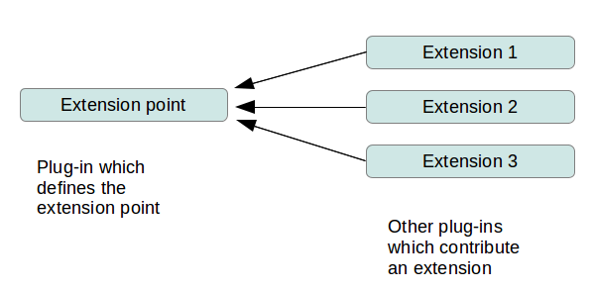
Overview

Slide 4
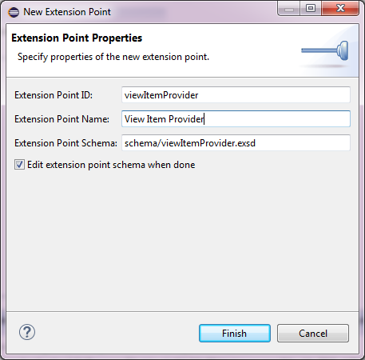
Extension Point
Create extension point
<plugin>
<extension-point id="viewItemProvider"
name="View Item Provider"
schema="schema/viewItemProvider.exsd"/>
</plugin>

Slide 5
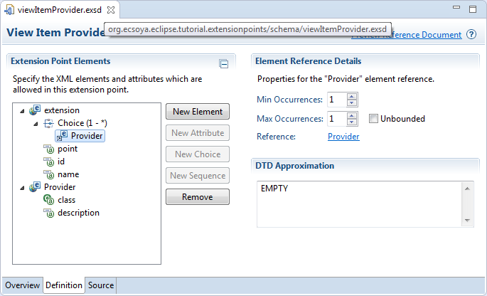
Extension Point
Define schema

Slide 6
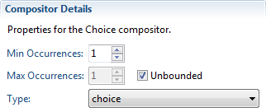
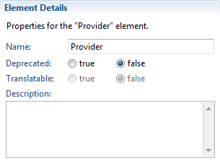
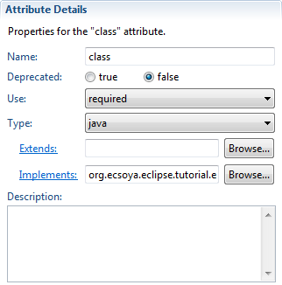
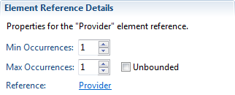
Extension Point
Element
Attribute
Use
optional
required
default
Type
string
boolean
java
resource
identifier
Compositor (Choice and Sequence)
Element Reference

Slide 7
Extension Points
Accessing extensions
IConfigurationElement[] elements = Platform
.getExtensionRegistry()
.getConfigurationElementsFor(
"org.ecsoya.eclipse.tutorial.extensionpoints.viewItemProvider");
List<IViewItemProvider> providers = new ArrayList<IViewItemProvider>();
for (IConfigurationElement elt : elements) {
try {
IViewItemProvider p = (IViewItemProvider) elt
.createExecutableExtension("class");
providers.add(p);
} catch (CoreException e) {
e.printStackTrace();
}
}

Slide 8
Extension Point
Exercise in Eclipse

Slide 9
Extension Points
Help Content
org.eclipse.help.toc
Welcome
org.eclipse.ui.intro
Perspective
org.eclipse.ui.perspectives

Slide 10
Any Questions?
Skype: jin.liu.soyatec
Email: jin.liu@soyatec.com

Slide 11
The end

